Slide 1
RELB 385 INTRODUCTION TO BIBLICAL FOUNDATIONS OF ETHICS
BY
PASTOR SOLOMON APPIAH

Slide 2
Let’s take a quick test!
Is a morally blameless/perfect life possible in contemporary society? What arguments can you give for your answer?

Slide 3
Overview of the Course
Have you been caught up in a situation when knowing just what to do is not easy?
Since you have been making decisions from birth until now, can you identify one ethical basis for doing what you do? How will your ethical theory fare on the scale of the Bible?
Without an adequate discovery of biblical foundations of ethics, chances are that you may not be able relate your ethical decision-making to the Bible.
It is for this reason that I especially welcome you to RELB 385: Introduction to Biblical Foundations of Ethics.

Slide 4
Overview of Christian Ethics

Slide 5
Definition & Concepts of Ethics
This section introduces the learner to the general definition and overview of the concept of ethics and specifically Christian ethics
Objectives
By the end of this section, you should be able to:
define Christian Ethics.
explain the types of Ethics.
differentiate Christian Ethics from philosophical Ethics.
compare related concepts in the study of Christian Ethics.

Slide 6
Definition of Ethics
The term ethics is derived from the Greek word ethikos which itself is derived from the Greek word ethos, meaning custom or character.
It is the branch of philosophy dealing with what is the proper course of action for man. It answers the question, "What do I do?"
It is the study of right and wrong in human endeavors. Ethics is a philosophical discipline that studies the distinction between good and wrong, and also evaluates the moral consequences of human actions.

Slide 7
What is Ethics?
Ethics is a branch of philosophy that is concerned with what is morally good and bad or right and wrong. When we begin to use such terms as right, wrong, good, bad, virtuous, sinful, ought, duty and obligation among others, we are directly within the confines of ethics. All these form the moral sense and the sentences in which they are made used to express moral or ethical judgments.
Look up the definitions of some ethicist like Robert Solomon, William Barclay, Norman Geisler, etc.

Slide 8
Aristotle was the first to use this concept in the title of his writing 'Nicomahica ethics'. But, reflections on morality existed from the beginning of the human life.
For example, Jewish people got the God given Ten Commandments, and the entire Bible is a calling to a righteous way of living. Antic Babylon had the Hammurabi's code of laws, India had Manu's laws.

Slide 9
Ethics defined variously…
William Barclay:
Robert Solomon:
Norman L. Geisler:
A contemporary definition of ethics, therefore, is the thoughtful reflection and evaluation of various systems of morality around which people organize their lives.

Slide 10
Ethics or moral is contrasted with non-moral rather than amoral or immoral. It has meanings which do not have such direct link as to give acceptable content to represent the direct contrasted of the word ethics or moral. The word ethics has to do with value systems arising from the reasoned or acceptable as against mere habitual or customary way of life. Immoral stands for the obscene behaviour like sexual immorality or that which offends acceptable standards of morality. This is the same as amoral which stands for anything that is contrary to acceptable behavioral (moral) conducts. Ethics therefore embrace, but surpass, discussions that centre on immorality or amorality.

Slide 11
Moral: concerned with principles of right and wrong
Immoral: behaviour that does not conform with acceptable standards of morality
Amoral: behaviour that lacks any sense of morality or is unconcerned with morality
Non-moral: not holding or capable of manifesting moral principles

Slide 12
What is Christian ethics?
Standards of right and wrong of human behaviour based on biblical standards and provisions.
Old Testament ethics
Ethics of Jesus Christ
Pauline ethics
Catholic ethics
Protestant ethics
Pentecostal ethics

Slide 13
Types of Ethics
There are three (3) types of Ethics.
These are:
normative ethics
meta-ethics and
applied ethics

Slide 14
Normative Ethics
Normative ethics (also called prescriptive ethics) is the branch of ethics that asks general questions about the morality of behaviour.
It attempts to provide general moral norms which serve as framework for regulating human behaviour. It is the study of what ought to be. It involves defining the moral standards of behaviour and the morality of actions, practices, laws and institutions.
In doing this, normative ethics may offer foundational principles or character traits of the morally good life.

Slide 15

Normative ethics
Social Ethics
Professional Ethics
Personal Ethics

Slide 16
Characteristics of normative ethics
They are theories or systems of moral values that prescribe what people ought to do in particular situations.
They are based on assumptions about what is good or bad, right or wrong, just or unjust.
They often take the form of rules or guidelines that tell us what we should and should not do in specific circumstances.
They are usually codified in legal systems and religious texts, but they can also be found in works of philosophy and literature.

Slide 17
Characteristics of normative ethics
Examples include utilitarianism (the idea that actions should produce the greatest happiness for the greatest number) and Kantianism (that a person’s intentions are irrelevant if their actions violate a moral rule).
For some people, normative ethics might mean living up to certain standards as dictated by society or religion; others might view it as following one’s moral compass regardless of what other people think.

Slide 18
Metaethics
Meta-ethics (also known as descriptive ethics) is the branch of ethics that surveys the general scope of ethics.
Meta refers to 'after or beyond.' It studies ethical concepts with the aim of determining their origins and meanings.
It includes the study of moral languages and terminologies as well as the means of moral awareness or moral ‘knowing’. It does not ask or make judgment about what types of action are moral and immoral; rather, it asks questions.

Slide 19
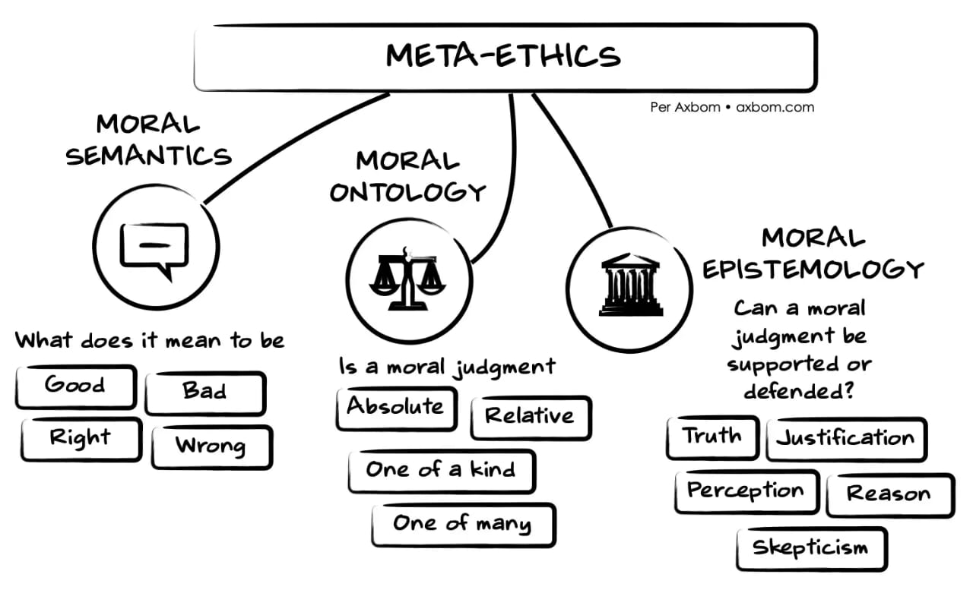
Notes:
What does it

Slide 20
Applied Ethics
Applied ethics (also called practical ethics) is the branch of ethics that seeks answers to relatively concrete questions about the morality of specific actions and policies. It addresses distinctively moral issues that are controversial in specific areas of work.
The following branches focus on various controversial moral issues of applied ethics:
Medical/healthcare ethics (euthanasia, abortion, human cloning, genetic engineering, fair distribution of prescription drugs and medical treatment etc. For example, is it wrong for doctors to deceive their patients; passive euthanasia is sometimes permissible).
Business ethics (corporate responsibility; rights and obligations of employees; diversity and discrimination etc. For example, lying and deception is permissible in business contexts).
Legal ethics (responsibilities of individuals working in the criminal justice system).
Environmental ethics (it’s morally wrong to exterminate rare species of animals and plants; raising animals in factory farms is morally wrong).

Slide 21
Quiz
According to Dennis P. Hollinger in his book, Choosing the Good: Christian Ethics in a Complex World, how does Arthur Holms define ethics? (3 marks)
What distinction does the author make between ethics and morality? (2 marks)

Slide 22
Quiz
If normative ethics is based on established norms and standards, identify any four (4) principles that make Christian ethics normative? (8 marks)
What is Christian Ethics? (2 marks)

Slide 23
Quiz
What is ethics? Situate your answer in the context of your course of study. (6 marks)
Identify any four (4) reasons why the study of ethics is important in contemporary society? (4 marks)

Slide 24
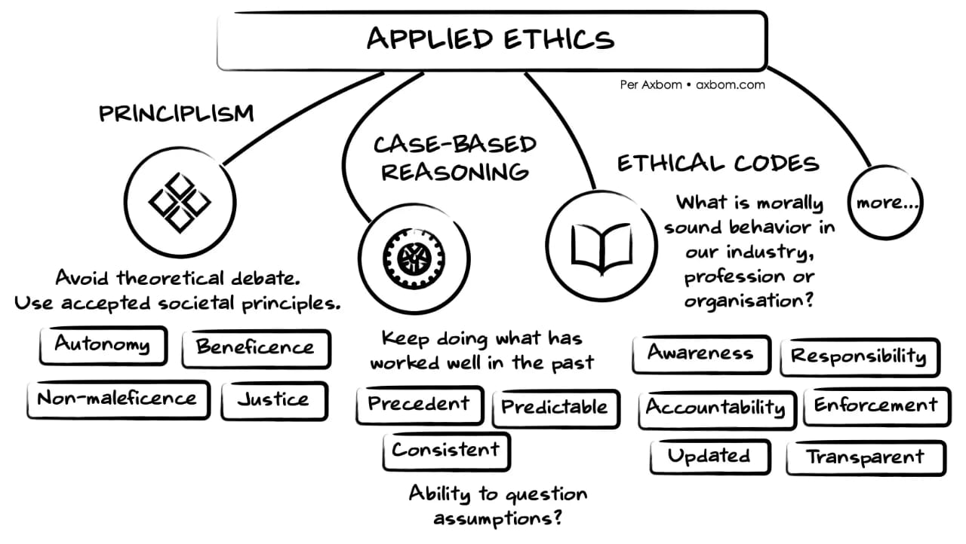

Slide 25
The Nature of Ethics and Morality
Morality is the innate sense of oughtness and obligation. Morality involves decisions in which the actor is aware of that his/her choice may be better or worse than another, but not from a functional standpoint but from the sense that we feel obligation, right and wrong.
Yet, not all choices in life are moral.
Morality elicits a sense of oughtness and obligation.
The nature of ethics and morality in the everyday experiences of the individual are those that carry the question that have to do with right, wrong, conscience, obligation and commitments that touch the core of who the individual is as a person.
Notes:
Take the work of a pharmacist for instance. The job is not a problem but if you have to sell abortion pills and you are a Christian who knows that abortion is sinful. Then your conscience comes to play.

Slide 26
Moral vs Amoral Issues
There is the tendency of turning moral issues into amoral ones.
When people argue that their decisions and choices are merely personal and that they lie outside the purview of ethics, the possibility of turning the moral implications of those so-called personal choices and decisions into amoral issues becomes apparent.
Examples:
Euthanasia/physician-assisted suicide
Abortion
Gunsmith
Galamsey
Despite the amoral tendencies, a question of morality arises from personal, institutional and social lines in terms of rightness or wrongness of these.
Morality is note merely about the big decisions but also about the little little everyday decisions and choices in relation to God, the self, others, culture and the entire world.
Notes:
Take the work of a pharmacist for instance. The job is not a problem but if you have to sell abortion pills and you are a Christian who knows that abortion is sinful. Then your conscience comes to play.

Slide 27
Moral vs Amoral Issues
From the foregoing, we can say that ethics is more of a normative discipline rather than a descriptive discipline.
The descriptive fields of study are those that recount human and institutional behavior in various spheres such as psychology, sociology, anthropology, economics, history, and political science.
Ethics is normative and prescriptive in that it attempts to establish norms, standards, and perspectives that guide human and institutional behavior and character.
In ethics, right means something different from correct.
Ethics emerge when we move beyond being directed by tradition or cultural rules and expectations and begin to reflect on what we ought to do and to be. It is a conscious attempt to analyze the moral situation and options that confronts us and to designate the moral good in the midst of the options.
Notes:
Take the work of a pharmacist for instance. The job is not a problem but if you have to sell abortion pills and you are a Christian who knows that abortion is sinful. Then your conscience comes to play.

Slide 28
Sources of Ethics
As a philosophical discipline, ethics may be sourced from
Religion
Cultural experience
Tradition/norms/codes
Law and legal systems
Philosophy

Slide 29
Sources of Christian Ethics
Christian ethics however is derived from 4 sources namely;
Scripture
Tradition
Reason
Experience

Slide 30
Christian Ethics and Philosophical Ethics
Christian ethics refers to the principles derived from the Christian faith by which we act.
It is a branch of Christian theology that defines concepts of right (virtuous) and wrong (sinful) behavior from a Christian perspective.
While God’s Word may not cover every situation we face throughout our lives, its principles give us the standards by which we must conduct ourselves in those situations where there are no explicit instructions.

Slide 31
Christian ethics is well summarized by Colossians 3:1-6:
“Since, then, you have been raised with Christ, set your hearts on things above, where Christ is seated at the right hand of God. Set your minds on things above, not on earthly things. For you died, and your life is now hidden with Christ in God. When Christ, who is your life, appears, then you also will appear with him in glory. Put to death, therefore, whatever belongs to your earthly nature: sexual immorality, impurity, lust, evil desires and greed, which is idolatry. Because of these, the wrath of God is coming.”
This implies that Christians focus on Jesus and what His requirements or expectations of humanity. Focusing on Jesus will enable Christians eschew all sorts of immorality.

Slide 32
Considering the defining features of Christian Ethics, one may adduce that it shares a characteristic with non-Christian or philosophical Ethics.
Both forms of ethics are principles that regulate human behavior in relation to others. However, a difference between Christian Ethics and philosophical Ethics can be identified (Crittenden, 1990).
Christian Ethics are based on values that are derived from God. It is a form of Divine Command that is dependent upon God's will and purposes for the human race. God commands what is good and prohibits what is evil (Heidt, 2010).
As such Christian Ethics seeks to apply the essence of Christian theology to the act of decision-making. In so doing, Christian Ethics shows up as participation in the life of God Himself (Mantzaridis, 2009).

Slide 33
But secular or philosophical Ethics are dependent on set of principles derived from shared human experiences (CVE, 2012).
According to Cox (1966: 27), philosophical Ethics are not the "direct expression of the divine will." Rather, the principles are the outcomes of that which other humans, at a point in time, experienced and valued.
Philosophical Ethics attempts to apply principles that are within the human perception of good and evil (Giannaras, 2011).

Slide 34
Related Concepts in the Study of Christian Ethics
Ethics is sometimes used interchangeably with other related terms in the field of decision-making or decision-evaluation. These related terms include law, morality, etiquettes, and civility. Let us now discuss the relationship between Ethics and these concepts.
Law and Ethics
In other words; State Laws and Government Laws go through a process to get approved, written into law, and then are enforced. But Ethics are like rules of conduct, they do not pass through such process.
A key difference is in terms of the sanctions which apply if these are violated. If you break an ethical code you may face disapproval from your peers, disciplinary proceedings from a professional body etc. Break the law and you could face a police investigation, a court appearance, various penalties like a fine or imprisonment etc.

Slide 35
Morality and Ethics
Ethics is the rules for deciding proper conduct. While not absolutely timeless, ethical principles change very little through the ages. Morality is the standards for behavior that exist at some point in time.
Compared to ethics, morality undergoes changes frequently. Since the principles of ethics are more fundamental and stable, ethics is bigger than morality. Ethics is able to call morality - the existing standards for conduct - into question, and cause morality to change.
As an example, consider slavery. Once it was considered moral to own slaves. Over time, ethics called the morality of slavery into question and the eventual result was that slavery was no longer considered moral.

Slide 36
Etiquette and Ethics
Ethics is about personal behavior right or wrong, but etiquette is about social norms, not about personal, but social standards. If you use fork rudely, it’s not unethical, but it’s not a good etiquette.
Civility and Ethics
Civility has to do with being a good citizen, a good neighbor. Civility is derived from the Latin civitas, translated as state, city-state, city, citizenship. It refers to the “cultivation of habits of personal living that are claimed to be important for the success of the community. The term civility refers to behavior between persons and groups.” But Ethics is a major branch of philosophy, the study of values and customs of a person or group and covers the analysis and employment of concepts such as right and wrong, good and evil, and responsibility.

Slide 37
Summary
This section focused on the overview of Ethics. The section defined Ethics in general. It also defined Christian Ethics and differentiated it from philosophical Ethics.
Among other things, it noted that Christian Ethics attempts to apply theological principles to decision-making and decision-evaluation whereas philosophical Ethics only applies values derived from general human experience to decision-making and decision-evaluation within the human framework of good and bad.
Further, the section discussed the relationship between Ethics and other related concepts such as law, morality, etiquettes, and civility.

Slide 38
Key terms
Ethics
Ethikos
Ethos
Normative
Meta-ethics
Applied Ethics
Christian Ethics
Philosophical Ethics
Law
Morality
Etiquettes
Civility

Slide 39
Check Your EQ (Ethics Quotient)
1. The Greek word ethikos is derived from another Greek word ethos, meaning custom. T/F
2. Ethics is only concerned with what is good, fair, and responsible. T/F
3. While Christian Ethics is based on valuable shared experiences, philosophical Ethics is based on God's will and purposes for humanity. T/F
4. Ethics is concerned with decision-making alone. T/F
5. Ethics is interested in character as well as conduct of human beings. T/F

Slide 40
Discussion Questions
1. Define Christian Ethics in the context of Colossians 3:1-6.
2. Distinguish Christian Ethics from philosophical Ethics.
3. Compare Ethics with law, morality, etiquettes, and civility. Indicate its relationship to each of these concepts.
4. List and explain the three (3) main types of Ethics.

Slide 41
End of Lesson One

Slide 42
Lesson Two

Slide 43
Varieties of Ethics and Moral Thought

Slide 44
Men go abroad to admire the heights of mountains, the mighty waves of the sea, the broad tides of rivers, the compass of the ocean, and the circuits of the stars, yet pass over the mystery of themselves without a thought. - Augustine, Confessions
Christian Ethics and Moral Philosophy

Slide 45
Introduction
“Ethics” is a term that usually refers to the academic study of morals and moral systems. We rarely appeal to the general idea of ethics but most often appeal to some specific account that we have in mind, as indicated by the use of a modifier.
We might, for example, speak of professional ethics or personal ethics. These modifiers help us to be more precise with our discussions. We can also talk about the various approaches that people throughout the world adopt with regard to ethics, given their own religious, cultural, and philosophical commitments.
As a result, there are Buddhist ethics, Jewish ethics, Hindu ethics, Islamic ethics, Maorian ethics, and Christian ethics.

Slide 46
Christian Ethics and Moral Philosophy
There are also specifically philosophical approaches to ethics, such as Kantianism, utilitarianism, contractarian ethical approaches, ethical relativism, continental ethical approaches, feminist ethics, natural law ethics, natural rights ethics, and virtue ethics.
These lists are not exhaustive, but they show that we need to have some qualifications on the term “ethics.”
This lesson is about the relationship between two kinds of ethics: the theories of ethics found in philosophy and approaches found in Christian ethics.
It is a conversation between philosophical ethical theories and the Christian tradition that many of these philosophical theories either emerged from or argued against.

Slide 47
Difference between Morality and Ethics
Morality concerns the principles and teachings about right and wrong that organize a group of people.
These include, for example, prohibitions against lying, murder, and theft, as well as exhortations to honor one’s parents and give aid to those who are suffering.
All human communities practice morality in one way or another. Yet not all people take the time to think about the nature of these principles: why they apply, how they apply, and what motivates us to abide by them.
Such reflection is the work of ethics, which requires asking important questions about the morality we practice.

Slide 48
Difference between Morality and Ethics
We can see this distinction at work in an experience from the life of Augustine (354-430), who is one of the most important philosophical and theological figures in the Christian tradition.

Slide 49
Difference between Morality and Ethics
In his spiritual autobiography, Confessions, Augustine recounts the story of how he stole some pears from a neighbor’s orchard.' He says that one evening some of his friends encouraged him to go out and raid the neighbor’s orchard for pears.
The pears were not particularly delicious, but Augustine wanted to go along because there was no fun in stealing them alone. He wanted “companions in crime.”
Augustine reflects that, had it not been for his morally suspect friends, he never would have stolen the pears, but there was a certain social dynamic that influenced his behaviour.

Slide 50
Questions that arise thus…
What did he find pleasurable in the experience?
To what extent was he personally responsible for his actions?
To what extent can we place the blame for our sinful actions on other people?

Slide 51
Difference between Morality and Ethics
In this brief narrative from the life of Augustine, we can see the difference between morals and ethics.
Morals are the collective values we live by—the values we ascribe to certain activities and goods.
Companionship is a value, but so too are self-restraint and respect for property that belongs to others.
Augustine’s morals as a young man had more to do with his desire for acceptance and pleasure than with a concern for integrity and respect.
Some people value money above all else, while others see a life of self-sacrifice as most valuable. Some people pursue pleasure at all costs, while still others believe that honesty in all circumstances is to be valued.

Slide 52
Difference between Morality and Ethics
The point here is that all people have morals since we all value some behaviours over others.
Yet we not only judge some moral behaviours as better than others; we also judge some moral systems as better than others.
We can ask whether we were justified in some action, whether our intentions were the appropriate ones in a given situation, and whether we followed the guidance of our conscience.
These and other questions begin the process of systematic reflection on morals—or what we call “ethics.”

Slide 53
Among those professionals who engage in the practice of ethics, we'll focus on two kinds: philosophers and theologians.
In general, philosophers consider life’s ultimate questions without regard to holding specific theological assumptions.
Historically, philosophy is the “love of wisdom” as developed by such figures as Socrates, Plato, and Aristotle. Philosophers often consider questions concerning the ultimate basis of reality, such as whether humans have free will, how knowledge is possible, and how the basic principles of logic work.
They also consider questions concerning the ultimate meaning of human existence, such as the nature of the soul and what constitutes the “good life.”
On all the aforementioned questions, their work oftentimes overlaps with that of theologians. When philosophers look at questions raised by ethics, this is known as moral philosophy—that is, the reflection on and the evaluation of moral principles and norms from the perspective of philosophy.

Slide 54
Theologians, however, take beliefs about God to form the core of their ideas about life.
They are not as concerned with proving God’s existence as they are with understanding God’s relationship to humanity and how reconciliation, salvation, and sanctification are possible.
In light of these concerns, theologians are often interested in how God’s relationship with humanity shapes and informs our behaviours toward one another and toward God.
When theologians consider ethical questions, this is usually known as moral theology—that is, the reflection on the moral principles and narratives as found in the Scriptures and church tradition from the perspective of faith.

Slide 55
There is not always a clear distinction between philosophers and theologians (and between moral philosophy and moral theology), since some philosophers have religious commitments, while others do not.
For example, Plato and Aristotle—two of the greatest Greek philosophers—both wrote extensively on ethical issues, including themes many Christians hold to be central to the life of faith such as justice, friendship, courage, and self-control.
Other philosophers such as Friedrich Nietzsche and Jean-Paul Sartre were openly hostile to Christian beliefs.
Still others like Augustine and Thomas Aquinas blur the lines considerably, since they not only engaged both philosophy and theology but also held to the idea that philosophy without the correcting influence of theology was fundamentally incomplete.
As a result, we see that there is often a great deal of overlap between what counts as moral philosophy and what counts as moral theology

Slide 56
Plato’s Moral Philosophy
Platonic thought makes much of eros, and eros means love. Yet agape though it also means love, is not the same thing as eros. Eros (which must not be confused with its modern derivative, "the erotic’) means a quest for the highest values, the harmonious adjustment of personality in a well-rounded life, self- fulfillment through seeking the good.
This is achieved in the individual only through promoting the well-being of others. It therefore involves mutuality in love. Its modern correlate is the quest for "the good life" through self-realization.

Slide 57
The Moral Philosophy of Aristotle
Aristotle’s eudaemonism, with its emphasis on a life of moderation with every man fulfilling the function for which he is fitted by nature, and thereby ensuring happiness, is a practical and down-to-earth system which still has much modern relevance.
The hedonistic, or pleasure- seeking, ethics of Epicurus was by no means the crass sensualism suggested by the oft-quoted ‘Eat, drink, and be merry; for tomorrow we die"; it centered in a refined enjoyment of congenial friends, simplicity of living, and freedom from tension in a cultured and unstrenuous life.
Stoicism, on the other hand, with its appeal to courage in the face of life’s vicissitudes and the pursuit of virtue solely for virtue’s sake, was both a more serious and a more religiously grounded ethic. Its doctrine of an all-pervasive World-Reason, or Logos, and of a natural law of morality fundamental to all existence and embracing in its scope all men, had a note of universalism which made Stoicism particularly open to amalgamation with Christian thought.

Slide 58
Other Moral Philosophies
These, of course, are not the only classical systems of moral philosophy.
There is the formal, duty ethics of Immanuel Kant with its categorical imperative, or unconditional demand, to treat all persons as ends, never as means, and to act only in such a way that one’s conduct could be universalized.
There is also the utilitarianism of Jeremy Bentham and John Stuart Mill, centered in the "greatest happiness of the greatest number" and the measurement of all courses of action by their usefulness toward this end.
There is also the more recent, but in its elements very old, "social adjustment" philosophy of John Dewey which measures right conduct by the ability to take one’s place as a good citizen in an ordered, democratic society.
It is apparent that there are good elements in all of these systems. But are they Christian?

Slide 59
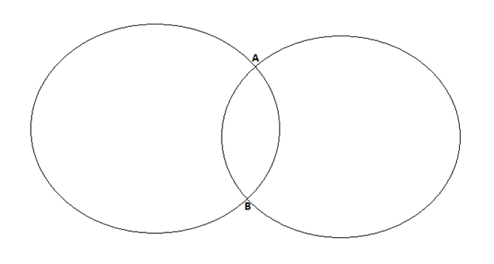
The Intersection of Moral Philosophy and Moral Theology
Ethics
Morals and moral systems
Moral philosophy
Moral theology
Notes:
One of the tasks we have in this text is to treat both philosophical and theological approaches to ethics from a Christian perspective. Too often, texts in theological ethics ignore the importance of such thinkers as Plato, Aristotle, Immanuel Kant, and Friedrich Nietzsche, while texts in philosophical ethics ignore the work of theologians such as Augustine, Aquinas, John Calvin, John Wesley, and Soren Kierkegaard (many of whom are also considered “philosophers”. In reality, theological issues have influenced many so-called secular thinkers, and philosophers have influenced much of Christian thought on ethical issues. As a result, we intend to bring these two disciplines into conversation with each other. We begin by laying out some of the different
approaches to these areas of ethics.

Slide 60
Methods in Ethics
Methodological approaches to ethics, at least in philosophy, generally examine assumptions, look for validity and cogency in arguments, consider counterexamples, and attempt to build theories that will appeal to people regardless of their religious convictions.
Some philosophers, such as Immanuel Kant and John Stuart Mill, appeal to qualities such as universality and rationality, while others, such as Friedrich Nietzsche and Michel Foucault, attempt to undercut every theory as somehow illicitly motivated by a hidden desire for power.

Slide 61
Methods in Ethics
What these various methodologies have in common is that they focus their attention on a consideration of values and principles without an explicit appeal to divine revelation.
Some philosophers reject all forms of religious belief, while others see religious beliefs as confirming truths that can be known philosophically.
Still other philosophers try to argue to religious truth from philosophical truths.
When we consider the views of Kant or Nietzsche, for instance, we need to remember that they are not assuming that God speaks directly to human beings, that they harbor deep suspicions about the binding nature of religious obligations, and that they often think strictly religious approaches are misguided.

Slide 62
Theological Approaches
There are a variety of ways in which to proceed in moral theology.
Some begin with the biblical narrative and advocate biblical ethics, while others begin with theological commitments such as human depravity, divine transcendence, or the encounter with God.
Some develop approaches systematically from a doctrine of God to an understanding of creation or to a theological anthropology, while still others emphasize the role of Christian churches in mediating the moral principles of the Bible to contemporary society.
Notes:
Many Protestant Christians, especially those in the evangelical tradition, look first to the Bible for moral guidance. Texts such as the Decalogue, or Ten Commandments (Exod. 20:1-17; Deut. 5:6—-21), and the Sermon on the Mount (Matt. 5—7) have a special place since they set out basic rules or principles that believers need to follow if they are to consider themselves true disciples. Protestants generally look to the Bible first and foremost and then to important theological figures who have interpreted the Bible in important ways. Such thinkers as Augustine, Luther, Calvin, and Wesley play important roles, but they are never on the same level of authority as Scripture.
In contrast, the Roman Catholic tradition holds that the Bible needs the authority of the church to address questions that Jesus and his disciples never faced. Catholics turn first to how their church has traditionally understood various passages and look especially to such figures as Augustine and Aquinas and how they interpreted and applied the tradition in their own historical and cultural contexts. For Catholics, one needs the necessary guidance of the church as found in such documents as the Catechism of the Catholic Church, papal encyclicals, and various ecumenical councils. From this per-spective, Scripture cannot be read in isolation from the authoritative role of the Christian community. Both Protestants and Catholics understand that the moral message of the Christian Scriptures has to be grasped, interpreted, and applied. How Chris-tians do this requires thinking about the meaning of the text, the context of the text, and whether or not that text has a direct bearing on our contempo-rary discussions. Within the context of moral theology, there are five main alternatives: biblical ethics, divine command ethics, agapistic ethics, narrative ethics, and natural law ethics.

Slide 63
Approaches to Moral Theology
Moral Theology
Biblical Ethics
Divine Command Ethics
Agapistic Ethics
Narrative Ethics
Natural Law Ethics

Slide 64
Characteristics of Christian Ethics
Ethics deals with what is morally right and wrong. Christian ethics deals with what is morally right or wrong for the Christian. Since Christians base their beliefs on God’s revelation in scripture, the Bible will be cited as an authority for conclusions on moral behavior.
God has not limited Himself to revelation in scripture; He also has general revelation in nature (Rom. 1:19-20; 2: 12:14).
Since God’s moral character does not change. It should be expected that there will be similarities and overlaps between God’s natural and supernatural revelations.

Slide 65
Characteristics of Christian Ethics
Christian ethics is based on the will of God
Christian ethics is based on God’s revelation
Christian ethics is prescriptive
Christian ethics is based on Scripture
Christian ethics is absolute
Christian ethics is deontological

Slide 66
What is a morally good action?
Numerous theories have been proposed concerning what is meant by a morally good action.
Let’s look at the various views that contrast with a Christian view of morality.

Slide 67
What is a morally good action?
Might is right
The ancient Greek philosopher Thrasymachus is credited with holding that “justice is the interest of the stronger party” in other words, what is morally right is defined in terms of who has the power.
Man is the measure
Protagoras, an ancient Greek Philosopher claimed that “man is the measure of all things” understood in the in the individual sense, this means that each person’s own will is the standard for what is right and wrong. The morally right thing to do is what is morally right to me.
What is right to me may be wrong for another and vice versa.
Notes:
Often, this is understood as political power, as in the case of Machiavelli, though it could mean physical, psychological or other kinds of power. Although this is not a widely confessed. Nonetheless it is too often practiced it has flaws fatal – 1. It fails to note the difference between power and goodness. It is possible to be powerful without being good and it is possible to be good without being powerful. 2. Evils thoughts from Nero to Stalin are sufficient evidence to refute the theory that might make right. The testimony of history is that power corrupts and absolute power corrupts absolutely.

Slide 68
The Human Race Is the Basis of Right
One way to avoid the radical individualism and ethical solipsism of Protagoras’ position is to use the human race as a whole as the standard for good. In this case, the part does not determine what is right for the whole, but the whole determines what is right for the part. In brief, mankind is the measure of all things.
Right is Moderation
According to Aristotle, morality is found in moderation. The right thing is the “golden mean” or moderate course of action. E.g. Aristotle believed that temperance is the mean between indulgence and insensibility. And pride is moderate course between vanity and humility. Likewise, course is the halfway point between fear and aggression.
To be moderate is often the wisest course. Even the Bible says.” Let your moderation be known unto all men” (Phil 4:5). The question is not whether moderation is often the proper expression of morality, but whether is the proper definition (or essence) of morality, there are several reasons for thinking that it is not the very nature of what is good.
Notes:
In response, it should be noted first that even the whole race could be wrong. Whole communities, like Jonestown, have committed mass suicide. What if the vast majority of the human race decides that suicide is the best “solution” to the world’s problems? Should dissenters be forced to conform? Second, the human race is changing, as are ethical practices. Child sacrifice was once more commonly approved as was slavery. Hence, we say the race has a better expression of values. But “better” implies a “best” by which the progress is measured. We cannot know that the human race is better or worse unless there is a perfect standard outside it by which it can be measured.

Slide 69
Right Is What Brings Pleasure
Springing from the Epicureans (fourth century BC), hedonists claim that what brings pleasure is morally right and what brings pain is morally wrong. But since few things are all pleasure or all pain, the formula for determining what is good is complicated. The good, they claim is what brings the most pleasure and the least pain to the greatest number of people.
There are many difficulties with this definition of good. First not all pleasure are good (e.g., sadism), and not all the pain is bad (e.g warning pain) second, what kind of pleasure should be used as the basis or test? There are physical, psychological, Spiritual and many other kinds of pleasure. Third are we to use immediate pleasure or ultimate pleasure as the test? Pleasures in this life or the next? Forth should it be pleasure for the individual, the group or the race?

Slide 70
Right Is the Greatest Good for the Greatest Number
Reflecting on the problems just mentioned, some utilitarians have defined moral rightness in terms of what brings the greatest good for the greatest number of persons in the long run. Some, like Bentham understand good quantitatively, while others, like Stuart Mill understand it qualitatively.
Right is what is Desirable for Its Own Sake
Following Aristotelian thoughts, some have defined good as that which is desirable for its own sake, in and of itself. That is, moral value is an end but not a means. It is never to be desired for the sake of anything else.

Slide 71
Right is Indefinable
Despairing of any hope of specifying what is morally good, some simply insist that good is indefinable. For instance G. E. Moore (1873-1958) argued that every attempt to define good commits the “naturalistic fallacy” of assuming that since pleasure can be attributed to good, they are identical.
Moore contended that all we can say is that “good is good” and nothing more. Attempting to define good in terms of something else makes that something else an intrinsic good.

Slide 72
Good is what God Wills
One final alternative is to define good in terms of what God wills.
This of course is the Christian view of the nature of good. The good is what God wills is good. Whatever action God specifies to be good is good action.
Conversely, if God wills an action to be evil, then it is evil. Thus, moral good is both ultimate and specifiable. It is ultimate because it comes from God.
It is specifiable because it can be found in His revelation to mankind.

Slide 73
Christian Ethical Foundations
Christian ethics rests on a number of biblical principles.
Some of these moral foundations are love, justice, honest, integrity and civility.
Christians are called to love God and have “integrity of heart.” Anyone who is called with always try to do what is right and strive to live moral and upright lives.
Living godly lives is the very foundation of personal moral ethics. Those who attempt to “love their neighbor” will apply these biblical principles in a loving way to society. And loving one’s neighbor is the foundation of social ethics.

Slide 74
Christian Ethical Foundations
Love
One of the most important of the numerous moral foundations of Christian ethics is love. God loves us and desires that we love Him too. Such love is a mutual love and is seen in the love between God the Father and God the Son. And we are to both love God and each other.
The Bible has many words that we translate into the one English word love:
Agape - is sacrificial love and means to love other persons unconditionally, despite their reaction to you or your love for them.
Philia – is a spontaneous natural affection and is also used in the word Philadelphia (brotherly love) and philia (friendship)
Chesed – this term is found in the OT. It describes unselfish love and is sometimes translated as “loyalty” or “steadfast love.”

Slide 75
Christian Ethical Foundations
The most frequently used word for love in the New Testament is agape. Agape love is an unselfish love that is based upon principle and therefore spontaneous and not motivated by any value or benefit. Christians are to love others despite disappointment and rejection from others.
We can equally define love as equal regard. Love means we value all people equally, regardless of their situation or circumstances or race.
The agape love we are to have for each other also applies to other moral foundations such as justice. Justice is based upon equal rights and responsibilities for each person.
Jesus also demonstrated Hesed love in His care for others and in His call for Christians to demonstrate love for others. He taught that the kingdom of God offered good news to to the poor and freedom to the oppressed, while providing sight to the blind and hearing to the deaf (Matt. 11:2-5; Luke 4:18).
Notes:
Jesus taught that the two great commandments in God’s law were to love God and to love your neighbor (Matt. 22:37-40). He provided the model for the expression of love to God and others. His own habits of religious activities (prayer, worship and obedience) provide a model to Christians to follow. His parable of the Good Samaritan (Luke 10: 30-37), provides insight in how we are to treat others even if we do not think of them as our neighbors. He also taught that Christians are to “love their enemies and pray for those who persecute them in order to be sons of the Father in heaven” (Matt. 5:44, 45)
The apostle Paul taught that love is the “law of Christ” and thereby supreme and sufficient (Gal. 5:14; 6:2). He also instructed that love is the foundation of Christian obedience. Even if we manifest the gift of the Spirit and do good works, they do not profit us unless they are done in love (1 Cor. 13:1-3) Paul also taught that God shows His love to us in that Christ died for us (Rom. 5:8) and that nothing will separate us from the love of Christ (Rom. 8:37-39). Such love is not just a theological truth; it is a love that “compels us” (2 Cor. 5:14) and provides us with an ability to live the Christian life.

Slide 76
Christian Ethical Foundations
2. Justice
This is another biblical moral foundation. Though it may not readily apparent because some words for justice are often translated as “righteousness” and “judgment”
Justice is the standard by which privileges and penalties are distributed within a society. It is the standard by which God measures human actions and attitudes, being one of the chief attribute of God; therefore, human beings created in God’s image must also do justly (Gen. 18:19).
God is the defender of the poor and the oppressed (Jer. 22:15-16; Ps. 10:17-18). Likewise, God’s special regard for the poor and weak in society must characterize His people. The Bible focuses specifically on the poor, the widowed, the fatherless, slaves, resident aliens and wage earners and those with disabilities (Job. 29:12-17; Ps. 146:7-9; Mal. 3:5)
Notes:
OT prophets like Amos and Ezekiel called for justice – a foundation which Christ Himself reiterated severally in the NT. He confronted the religious leaders of His day and warned them not to neglect “the more important matters of the law – justice, mercy and faithfulness” (Matt. 23:23). In the same way, Paul admonished Christians not to be just hearers, but also doers of the word (Rom. 2:13)
A biblical imperative on justice is a crucial moral foundation.

Slide 77
Christian Ethical Foundations
3. Honesty
Honesty, another Christian moral foundation includes being honest in our dealings with others and being honest and truthful in what we say.
In the OT, there is the urgent call on people to deal honestly with one another (Lev. 19:35 says, “Do not use dishonest standards when measuring length, weight or quantity.” Likewise Proverbs 11:1 says “The lord abhors dishonest scales” believers are to use honest scales and are to deal honestly with others. A righteous person does not “accept a bribe against the innocent” (Ps. 15:5). Isaiah (5:23) pronounces judgment on those who acquit the guilty for a bribe, but deny justice to the innocent.
The New Testament admonishes Christians to have “good conscience” and to act “honorably” in all circumstances (Heb. 13:18). Paul said he always attempted to have good conscience toward God and before men (Acts 24:16).
Notes:
Other biblical injunctions for honesty include; Gen. 43:12; 2 Kin. 12:15; 22:4-7; Neh. 13:13.
Honesty requires telling the truth. The Third Commandment forbids the swearing of false oaths, the Ninth Commandment prohibits the bearing of false testimony (Ex. 20:7, 16; Deut. 5:11, 20; cf. Lev. 19:12; Jer. 7:9). In the OT, false witnesses were to suffer the same punishment that they had wished for the innocent (Deut. 19:16-20)
Telling the truth also involved more than false testimony in court, believers are not to spread false reports (Prov. 12:17; 14:5, 25) or report the truth maliciously or engage in slander (Lev.19:16; Prov. 26:20). Speaking evil is prohibited (Ps. 34:13; Prov.24:28; Eph. 4:31; Jas. 4:11; 1 Pet. 3:10) and it disqualifies a person from God’s favor (Ps. 15:3) and from a leadership position in the church (1 Tim. 3:8; Titus 2:3)

Slide 78
Characteristics of Christian Ethics
4. Integrity
Integrity is a character quality that we often talk about but do not see quite as regularly in the lives of public officials or even in the lives of the people with whom we live and work. The word integrity come from the same Latin root as integer and implies a wholeness of person. Just as we would talk about a whole number, so also we would talk about a whole person who is undivided
In the Sermon on the Mount, Jesus talked about those were “pure in heart” (Matt. 5:8) implying an undividedness in following God’s commands. Integrity therefore does not only imply undividedness, but a moral purity as well.
Numerous examples of lives of integrity, good character, and moral purity can be found in the Bible. 1 Kings 9:4 – Solomon, 1 Chron. 29:17 – David etc.

Slide 79
Parameters of Christian Moral Conduct
Parameter is defined as any constant limiting factor with variable values.
The parameters in ethics are called moral values. Value is also defined philosophically as the statutes in the scale of preference. Everything that comes to our conscience is evaluated.
In examining the nature of value, one will realize that there are two types of values namely; intrinsic and extrinsic values.

Slide 80
Parameters of Christian Moral Conduct
Intrinsic values
These are things that inherently or essentially are of value in and of themselves. They do not need external pressure to be what they are. Human Beings are of intrinsic value. Human life is intrinsic because there is the image of God in man. Pleasure, health and knowledge are often said to be intrinsic goods because they seem (typically) to be ends in themselves and not tools for obtaining some higher goods.
In ethics, “intrinsic” is used in reference to goodness or value to distinguish instrumentally good things (things which are good only because they are needed in order to obtain other good things) from things which are good in themselves.

Slide 81
Parameters of Christian Moral Conduct
Extrinsic values
These are accessory, not belonging, not intrinsic. These are values which we place on things.
Values which on themselves will amount to nothing but we place value on them.
They are sometimes called symbolic values.

Slide 82
Parameters of Christian Moral Conduct
In discussing the types of values, it noted that not all values are moral values. We can have economic value like money or aesthetic value like beauty or the strategic value from the point of war or in the art of war; this refers to the overall plan or the position of the army. Again, not all values are necessarily moral.
Sometimes, there are attachment and confusing value. Moral values must therefore be distinguished from other values. The factors for recognizing the difference can be seen in the following ways:
Moral values define traits human character. Honesty is a moral value. Kindness, peace, justice, and etc.

Slide 83
Parameters of Christian Moral Conduct
Moral values describes and intentions. So purity is a moral value, benevolence, nobility. Noble intensions are very important because we can be evil but noble intensions bring out valuable motive. Jesus admonishes us not to guess or judge other person’s motives.
Moral values describe things that are essential and necessary for human beings, that which when neglected or not accepted will reduce human dignity or wholeness thereby making man incomplete or not whole. Dignity, life, freedom, sanctity, space, food and drinking. All these values are placed differently on scale. The Bible does not only give moral values but shows how to put them on a scale of preference – how to choose.

Slide 84
Functions of Moral Values
Moral values have functions. Values were created by God. Genesis 1 and 2 tells us some types. The word good expresses value. Value functions in five (5) ways.
To attract and motivate human will
The role of value is to indicate minimum standard. We can give in up to the essential value. If we compromise out on essential values, we are losing out on life.
Values calibrate (mark, scale of measurement) norms. More value, more norm, more important value, more important norms. Proverbs 23:24
The role of moral is to justify norm
Values participate in guiding our moral lives. These are accomplished in three (3) ways
Notes:
In quick incidental decisions
Values help us when norms conflict. It does always resolve the issue e.g. obedience to God or man
Values usually lead to habitual decisions. Real life is made out of big decisions. It is rather made in small decisions. E.g. adultery starts from the head (brain) and not in bed. Norms make us to take big decisions.

Slide 85
Foundations of Christian Moral Conduct with Creation as Basis and Man as a Moral Being
Christian moral activity does not exist in a vacuum.
There is no morality without knowing and human beings and the vice versa. Good life is a fruit which has roots. Fruits must bring certain food into it. There are certain definite foundations of moral conduct.
These can be analyzed from our view of God, of man and of scripture. Our view of man is very significant in understanding his moral conduct.
The purpose of Christian morality is to produce moral Christians and to make man whole and holy. It is important to understand man and the way he is. To capture the very essence of man we have to go to his roots to know the beginnings. Where did life begin and how did man come into existence?
Notes:
It is upon this question that creation is seen to have moral significance as well as theological and social significance. The scientists, existentialists and humanists point to man’s beginning as an accident, like chance or an happenstance to which man has no control and cannot trace his roots. According to Darwin, man evolved from lower forms or primates and has developed to the present stage. Other scientists say our fate is determined. We are controlled by forces beyond our control.
Man is not the result of happenstance as the scientists would have us to believe. Creation is rational and morally significant showing and directing us to our very beginning. It gives us moral responsibility.

Slide 86
Foundations of Christian Moral Conduct with Creation as Basis and Man as a Moral Being
First, Man Has A Noble Origin
Every human being put heavy emphasis on the point of identity. It is morally important for every human being to remember where he came from.
We are not ordinary. We are not cheap people. We are of a noble origin.
God is the noblest being that has ever existed therefore when we sin we act cheaply and puts at stake God’s reputation. God made us wonderfully, exceptionally and very special.
We are princes and princesses – heirs of God’s throne.

Slide 87
Foundations of Christian Moral Conduct with Creation as Basis and Man as a Moral Being
2. Man was created in the image of God
We are exceptional. We are like God. We need not belittle ourselves. We are not just made anyhow. We were made and created according to the true blueprint.
The original plan of which we are made is eternal and man was to exist for eternity. God has not abandoned this plan for man. If I am like God, I must act and live responsibly and respectfully. I can hope and strive to be good and holy like God. I am open to grow and progress to the full stature of the fullness of God.
God’s character and nature is the original plan which we are copying. God is the measure and standard, the plumb line of our ethical bite.

Slide 88
Foundations of Christian Moral Conduct with Creation as Basis and Man as a Moral Being
3. We were created with individuality
Man is like God because he is different from God. This is the meaning of individuality. It is the uniqueness of every human being.
No one is the repetition of another. All and everyone is unique. E.G. White states in Education page 17 that “Every human being created in the image of God is endowed with powers akin to God. God created us to be like Him but unique.
Individuality is the power to reason and think and do. God created and broke the mold. He never repeats the old mold. Sin and deformity cannot manifest in the image of God.

Slide 89
Foundations of Christian Moral Conduct with Creation as Basis and Man as a Moral Being
4. Man was planned for
Creation was not an afterthought. We were not made by accident, creation was planned. We are not to abuse our procreative powers.
It was only when everything necessary for man was accomplished that man was created. Gen. 1:27-29. “Let us make man” every human being’s worth is measured by Christ’s death.
In eternity God had an agenda. It is when the heavenly council planned the new type of being that man was created. Man was formed.

Slide 90
Foundations of Christian Moral Conduct with Creation as Basis and Man as a Moral Being
5. Man was made with a purpose for a purpose to achieve a purpose
The creator Himself has a purpose for man and His purpose for man is for man’s own good (Jer. 29:11).
Myles Monroe noted that “the greatest tragedy of life is not death but a purposeless life.”
Rick Warren admonishes us to live a purpose driven life.
Notes:
The Bible has revealed certain moral precepts that define morality. Scripture consistently teaches that God is the sovereign ruler who can do what He wishes in the universe and among the inhabitants of the earth. God is the absolute standard of morality, His nature and character. The Bible has ethical standards and it is derivative from God who alone is the standard for morality. What God spoke in the Bible applies universally to all cultures.
The implication of the scientific theory is that it has little regard for mankind. It reduces our dignity. This theory has no place for morality and places less emphasis or value on morality. Creation upholds man as morally valuable and dignified. Man is empowered and entrusted with the rest of creation (Gen. 1:27-31) and as a steward and caretaker who is responsible (Gen. 2:19, 20). Man has intelligence and discernment. The scientific view has no basis and proofs to validate their theories about origins.

Slide 91
Man as a Moral Being
Man is a moral being and also a mixture of other facets such as the spiritual, the emotional, physical, psychological and social nature. Man is an intelligent being. Man’s moral nature is directly related to ethics which has to do with character, manners and conduct or habits. The study of ethics offers man the capacity to judge himself. Man has the capability of listening, hearing, seeing and even coming out of oneself to look at himself without losing himself (introspection). Inanimate things are not able to do that. Plants are not able to do just that
Man has a moral being has the capacity and capability to evaluate his own attitude and is able to put etiquette to things. He has the knowledge of putting values to things being right or wrong. He has the ability to label attitude right or wrong. Other creatures cannot differentiate between right and wrong. They are unable to do that.
Notes:
Man as a moral being can evaluate actions (habits) conduct and character and being involved in the process he is able to discern habits. Man has the capability and capacity of discerning consequences of actions and he is able to look ahead (even though with some limitations) and evaluate consequences. He sees beyond and has foresight and illumination. Man knows his limits and being aware he can act responsibly.
Ethics helps us to distinguish between right and wrong and to show the justification for the distinction. It helps us in making daily decisions in a right way and to deal with ethical issues like abortion, capital punishment, euthanasia etc. ethics is in every facet of life and in all professions. Its study is essential.

Slide 92
Micah 6:8
Ethics in the Hebrew Scriptures
He has told you, O mortal, what is good; and what does the Lord require of you but to do justice, and to love kindness, and to walk humbly with your God?

Slide 93
Matthew 7:12
Ethics in the Christian Scriptures
Therefore, whatever you want men to do to you, do also to them, for this is the Law and the Prophets

Slide 94
Class Test
20 minutes

Slide 95
Answer all questions
Under which category will you classify the law "Thou shalt not murder"? Give a Christian ethical justification for your answer (3 marks)
As a Christian who subscribes to the non-consequentialist ethical view, why would you advise your friend not to abort an unplanned pregnancy? (5 marks)
What is Scott Rae’s foundational consideration for making moral judgments? (2marks)

Slide 96
Class Test
30 minutes

Slide 97
Answer all questions – write short answers (10 marks)
What is the difference between ethics and morality? (1 mark)
What five creationist principles mandates humans beings to function within the realms of morality? State only four (4) (2 marks)
State any four (4) of the six (6) characteristics of Christian ethics (2 marks)
Define ethical situationism as proposed by Joseph Fletcher (2 marks)
Under which type of ethics would you classify the ethical injunction, “thou shalt not steal”? State two characteristics of that type of ethics (3marks)

Slide 98
Viewing Christian Ethics with African Lenses
“The African is notoriously religious”
- J. S. Mbiti, 1969

Slide 99

Customary OR Traditional Reflective Morality
Notes:
NOTE:
To change the image on this slide, select the picture and delete it. Then click the Pictures icon in the placeholder to insert your own image.

Slide 100
Traditional/Reflective Morality
We are all born into certain indigenous moral settings. These indigenous moral settings are traditional and customary to our specific circumstances, whether environmental, religious, political or social. It is often called first morality.
We come in contact with the morality that exists in various cultures and society and is usually based on custom or tradition. It is presented to its members without critical analysis or evaluation. Throughout their childhood and adult years many customs and traditions are quite effective and helpful in creating moral societies but to be effective and continuously applicable to the members of a society.
They must be critically analyzed, tested and evaluated and this is where reflective morality comes in.

Slide 101
What is Reflective Morality?
Philosophers in general demand of themselves and others that every human belief, proposition or idea be examined carefully and critically to ensure that it has its basis in truth.
Morality is no different from any other area of philosophic study in this respect.
Philosophers do not suggest that customs or traditions be eliminated or thrown out, but they do urge human beings to use reason to examine the basis and effectiveness of all moral teachings or rules, no matter how traditional or accepted they are. In other words, philosophy requires human beings to reflect on their moral customs and traditions to determine whether they should be retained or eliminated.
The Greek philosopher called Socrates (470? – 399) said, The unexamined life is not worth living by.

Slide 102
What is Reflective Morality?
For morality, a corollary might be experienced. Therefore, just as people should not accept statements or propositions for which there is no proof or significant logical argument, so they should not accept moral customs or traditions without first testing them against proof, reason and their experience – “the unexamined custom or tradition is not worth living by.”
It is important then that all customs, traditions, systems of ethics, rules, and ethical theories be carefully analyzed and critically evaluated before we continue to accept or live by them.
Again, we should not reject them out of hand, but neither should we endorse them wholeheartedly unless we have subjected them to careful logical scrutiny.
Be reflective in dealing with morality and moral issues.

Slide 103

THE CONSCIENCE

Slide 104

What is Conscience?
Of all the differences between human beings and the lower animals, the moral sense or conscience is by far the most important.
It is summed up in that short but imperious word “ought” a word with so high significance.
It is the most noble of all the attributes of man leading him without a moment’s hesitation to form the genius of his/her life that differentiates him from other creatures.
The conscience impels simply by the deep feeling of right or duty, to sacrifice it in some great cause.
Charles Darwin (cited in the prologue to Marc D. Hauser, Moral minds)

Slide 105

What is Conscience?
The word “conscience” is a blend of two Latin words con (with) + scientia (knowledge) or more appropriately cum (together) + scire (to know).
Thus “conscience” means knowing together, literally.
Several definitions have been advanced in a quest to explain this central human creationist endowment.

Slide 106
What is Conscience?
Conscience is our lived knowledge of good and evil. Our judgement about how we should act and our commitment to do so.
The conscience is a moral faculty or feeling that prompts us to see that certain actions are morally right or wrong.

Slide 107
What is Conscience?
Conscience is a person’s moral faculty, the inner core and sanctuary where he/she knows him/herself in confrontation with God and with fellow human beings – (Bernard Haring)
An inward moral impression of one’s actions and principles…as the inward faculty of moral judgement … as the inward moral and spiritual frame.

Slide 108
What is Conscience?
Our most secrete core and sanctuary where we encounter God; our heart.
A law inscribed in our hearts by God and recognized as our own; its voice calls us to love and do what is good and avoid what is evil.

Slide 109
What is Conscience?
Our moral compass that directs us to good or evil.
Our moral sensory faculty: capacity to see, feel, hear, smell and touch the good.
Our moral appetite which helps us to judge moral questions (intellect, feeling, imagination and will).

Slide 110
What does the Conscience do?
The conscience is an act of the intellect—the judgement of reason.
The conscience at a particular instance is the operation of reason. A process in which the general norms of the moral law are applied to concrete action which a person is about to perform or has performed.
The conscience tells the person that his/her moral obligation is here and now or judging his/her past acts.

Slide 111
The Essential Parts of the Conscience
There are two (2) essential parts of the conscience:
Synderesis
Conscientia
Synderesis: this part discovers very basic moral principle. It is the use of right reason by which we learn basic moral principles and understand that we have to do good and avoid evil. (this is the starting point of moral judgement).
Conscientia: this is the conscience proper. The practical reason which tells us what to do in a particular moral situation. (this is the end point of moral judgement).

Slide 112
Role of the Conscience
The conscience functions in two ways:
To Investigate moral actions
To Judge moral actions
By investigation, the conscience approves, reproaches, forbids and accuses.
By Judgement, the conscience works as the moral arbiter.
By passing judgement, the conscience functions to commend, to condemn, to command and to absolve.
The conscience thus helps to discern and command moral duty and obligation.

Slide 113
When Does the Conscience Address Us?
As noted earlier, the conscience addresses us about moral issues, not questions of fashion or taste or scientific fact. We can’t say, for instance, to grow apple trees, or to like paintings by Gauguin. Those are not moral issues.
The conscience does not speak to us about taste in music or art. The conscience doesn’t help us predict the direction of stock-market activity. Clearly, there are some things about which the conscience is not qualified to speak.
The conscience addresses strictly moral choices and deeds.

Slide 114
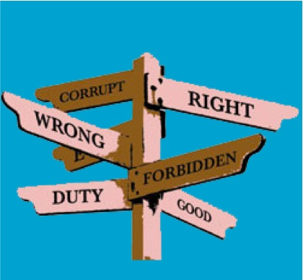
Making Moral Decisions

Slide 115
What is a Moral Decision?
A moral decision is the justification given for a moral act.
Such a justification is usually based on the moral actor’s ethical position which is based on several factors to either commend and condemn an action.

Slide 116

Moral Decision-Making
How do we make proper moral choices based upon Biblical principles? The Bible does provide Biblical guidelines on a vast array of issues.
Christians also have the liberty to make individual moral choices in areas of moral neutrality. Ultimately making moral choices involves discerning the will of God in one’s life.
How do we know the will of God? The following principles will be a mere summary of what has been discussed at length elsewhere.

Slide 117
Moral Decision-Making
Various Christian groups and denominations also disagree about particular points concerning how we discern the will of God. Therefore the following are a summary of those points that are held in common agreement by most Christian.

Slide 118
Moral Decision-Making
First, we can know God’s will through the Bible. Before considering any other way to discern God’s will, one should ask whether the Bible has already provided guidance in a particular area. The Bible is full of God’s specific commands and principles.
For example, a person does not have to ask if he should get drunk because the Bible has already addressed that issue (Eph. 5:18), nor does a business man have to ask if he should cheat in his income taxes, for the Bible has spoken to that question (Rom. 13:7). An unmarried couple does not need to ask if they should live together before they marry, again, the Bible has addressed that issue (1 Cor. 6:18)
The Bible provides boundaries and barriers to our moral actions. We are to stay within those moral boundaries. Paul, writing to the church in Corinth told them, “Do not go beyond what is written.” (1Cor. 4:6)

Slide 119
Moral Decision-Making
A second way we discern God’s will is through prayer.
We are commanded to bring our requests before God in Phil. 4:6. We are told, “Do not be anxious about anything, but in everything, by prayer and petition with thanksgiving, present your requests to God.”
If we are earnestly reading the Bible and seeking God’s will, He will reveal it to us often through the work of the Holy Spirit in our lives. We read in Rom 8:27 that the Spirit intercedes for the saints in accordance with the will of God.

Slide 120
Moral Decision-Making
A third way we discern God’s will is through our conscience. If our conscience is troubling us about a particular action or behavior then we should refrain from that activity.
Paul said, “Each person should be fully convinced in his own mind” (Rom. 14:5). He added that “everything that does not come from faith is sin” (14:23)
The opposite is not necessarily true. In other words, conscience is a good stop sign but not a green light.

Slide 121
Moral Decision-Making
A troubled conscience is sufficient justification to refrain and a guilty conscience is reason enough to stop a particular action or behavior.
A clear conscience, however, is no justification for proceeding. The Bible teaches that “the heart is deceitful above all things and beyond cure, who understands it” (Jer. 17:9) we can easily deceive ourselves into sin.
Christians should strive to have a good conscience before God and man (Acts 24:16). A troubled conscience is reason to avoid an action, but a clear conscience may not be sufficient justification to proceed.

Slide 122
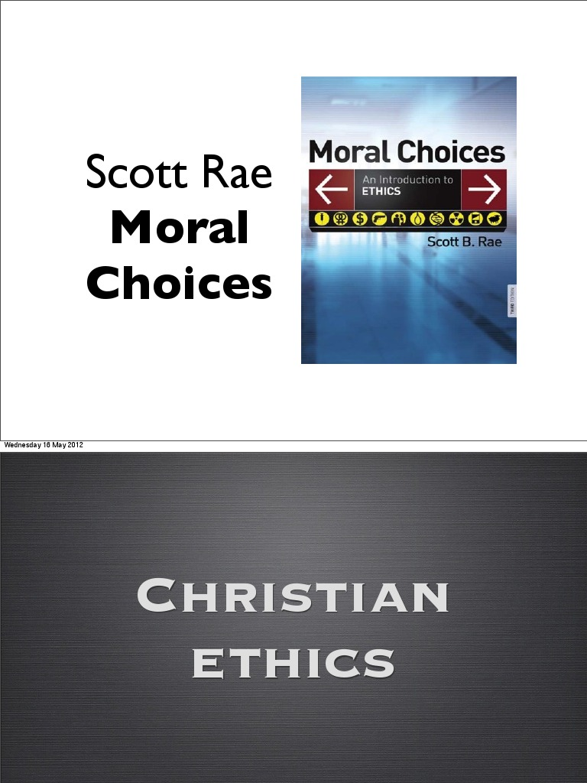
Scott Rae’s 7-Step Moral Reasoning Model
Scott Rae, in his book, Moral Choices (2018), proposed a moral reasoning model that could be used as a guide in making moral decisions.
Rae’s moral reasoning model does not guide one to an absolutely correct or “right” answer or decision to a moral dilemma; rather, his model may guide an individual to ask the right questions to ethical deliberation (Rae, 2018).

Slide 123
Scott Rae’s 7-Step Moral Reasoning Model
1. Gather the Facts
It is essential that in moral decision- making, one has to know the general facts of the moral situation, before coming up with a moral analysis, more so, a decision or an evaluation.
The simplest way of clarifying an ethical dilemma is to make sure the facts are clear.
Ask: Do you have all the facts that are necessary to make a good decision? What do we know? What do we need to know? In this light it might become clear that the dilemma is not ethical but about communication or strategy (Rae, 2018)

Slide 124
Scott Rae’s 7-Step Moral Reasoning Model
2. Determine the ethical issues
After having identified the facts and overall context of the moral situation, the ethical issue/s involved in the situation, must be clearly stated in order to specify what issue one has to make a decision to.
This section must likewise clearly state the major moral dilemma involved in the case.
Ethical interests are stated in terms of legitimate competing interests or goods. The competing interests are what create the dilemma. Moral values and virtues must support the competing interests in order for an ethical dilemma to exist.
If you cannot identify the underlying values/virtues then you do not have an ethical dilemma. Often people hold these positions strongly and with passion because of the value / virtue beneath them (Rae 2018).

Slide 125
Scott Rae’s 7-Step Moral Reasoning Model
3. Determine what virtues / principles have a bearing on the case
Applicable ethical values and principles relevant to the case must be identified and briefly explained in order to justify how such principles could be used in coming up with a decision concerning the moral dilemma later on.
In addition, the sources of these principles must be acknowledged likewise.
These values, principles could come from: (1) established philosophical ethical principles; (2) socio-cultural norms; (3) socio-political norms and laws; (4) religious traditions; and others.
In an ethical dilemma certain values and principles are central to the competing positions. Identify these. Determine if some should be given more weight than others.
Ask what the source for the principle is - constitution, culture, natural law, religious tradition... These supplement biblical principles (Rae 2018).

Slide 126
Scott Rae’s 7-Step Moral Reasoning Model
4. List the alternatives
After having identified relevant values, virtues, and principles involving the moral situation, possible alternative courses of actions must then be proposed and briefly explained.
These suggested courses of actions must then be evaluated based on its applicability, sensibility, practicality before selecting one as the course of action or decision to be made regarding the moral situation.
Creatively determine possible courses of action for your dilemma. Some will almost immediately be discarded but generally the more you list the greater potential for coming up with a really good one. It will also help you come up with a broader selection of ideas (Rae 2018).

Slide 127
Scott Rae’s 7-Step Moral Reasoning Model
5. Compare the alternatives with the virtues / principles
The initial list of suggested courses of actions must then be evaluated from the vantage point of the identified ethical values and principles.
This step eliminates alternatives as they are weighed by the moral principles which have a bearing on the case. Potentially the issue will be resolved here as all alternatives except one are eliminated. Here you must satisfy all the relevant virtues and values - so at least some of the alternatives will be eliminated (even if you still have to go on to step 6).
Often here you have to weight principles and virtues - make sure you have a good reason for each weighting (Rae 2018).

Slide 128
Scott Rae’s 7-Step Moral Reasoning Model
6. Consider the consequences
If principles have not yielded a clear decision consider the consequences of your alternatives.
Take the alternatives and work out the positive and negative consequences of each.
Estimate how beneficial each positive and negative consequences are – some might have greater weight than others (Rae 2018).

Slide 129
Scott Rae’s 7-Step Moral Reasoning Model
7. Make a decision (including one’s justification for the decision)
After having analyzed the moral dilemma situation (from steps 1 through 6), one must now make a decision based on what has been previously discussed and must clearly justify the decision that has been made.
Ethical decisions rarely have pain-free solutions - it might be you have to choose the solution with the least number of problems / painful consequences (Rae 2018)

Slide 130
Moral Reasoning

Slide 131

Moral Reasoning
Moral reasoning is the study of how people think about right and wrong and how they acquire and apply moral rules.
It is a subdiscipline of moral psychology that overlaps with moral philosophy, and is the foundation of descriptive ethics.

Slide 132
Moral Reasoning
Moral reasoning refers to the reasoning process by which human behaviors, institutions or policies are judged to be in accordance with or in violation of moral standards. Moral reasoning always involves two essential components
An understanding of what reasonable moral standards require prohibit, value or condemn and
Evidence or information that shows that a particular person, policy, institution or behavior has the kinds of features that these moral standards require, prohibit, value or condemn

Slide 133

Add a Slide Title - 3
Moral factual information Moral judgment
Standards concerning policy, institution or the rightness or wrongness of behavior under consideration of the policy, institution or behavior

Slide 134
Analyzing Moral Reasoning
There are various criteria that ethicists use to evaluate the adequacy of moral reasoning.
First and primarily, moral reasoning must be logical. The analysis of moral reasoning requires that the logic of the argument used to establish a moral judgment be rigorously examined, all the unspoken move and factual assumptions be made explicit and both assumptions and premises be displayed and subjected to criticism.

Slide 135
Analyzing Moral Reasoning
Second, the factual evidence cited in support of a person’s argument must be accurate, relevant and complete. If the moral reasoning is to be adequate, statistics and relationships must be accurate.
They must rest on reliable statistical methods and well supported scientific theory.
In addition, evidence must be relevant. It must show that the behavior, policy or institution being judged has precisely those characteristics that are prescribed by the moral standards involved.

Slide 136
Analyzing Moral Reasoning
Third, the moral standards involved in a person’s moral reasoning must be consistent.
They must be consistent with each other and with the other standards and beliefs the person holds.
Inconsistency between a person’s moral standards can be uncovered and corrected by examining situations in which these moral standards require incompatibility things.

Slide 137
Analyzing Moral Reasoning
Suppose that I believe that;
It is wrong to disobey an employer whom one has contractually agreed to obey, and I also believe that
It is wrong to help someone who is endangering innocent people’s lives.
Then suppose that one day my employer insists that I work on a project that might result in the death of several innocent people. The situation now reveals an inconsistency between these two moral standards: I can either obey my employer and avoid helping disloyalty, or I can disobey him and avoid helping endanger people’s lives, but I cannot do both.

Slide 138
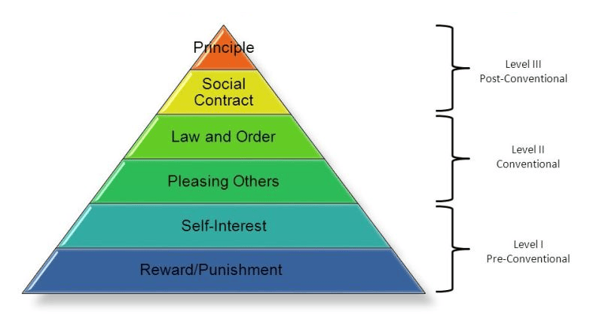
Moral Development and Moral Reasoning
Level I – Pre-Conventional stages
Stage 1. Punishment and obedience orientation
Stage 2. Instrumental and relative orientation
Level II – Conventional stages
Stage 3. Interpersonal concordance orientation
Stage 4. Law and order orientation
Level III – Post-Conventional, autonomous
or principled stage
Stage 5. Social contract orientation
Stage 6. Universal ethical principles orientation

Slide 139

SECULAR ETHICAL SYSTEM

Slide 140
Secular Ethical Systems
Our study of ethics thus far has been rooted in the Bible and biblical principles.
But many philosophical systems of ethics do not start with this biblical presupposition.
The following is a brief summary of the more popular contemporary ethical systems that rest on secular assumptions rather than a biblical foundation.

Slide 141
Cultural Relativism
A student in a class on anthropology cannot help but notice the differences between various cultures of the world. Differences in dress, diet, and social norms are readily apparent.
Such diversity in terms of ethics and justice are also easily seen. These are apparently shaped by the culture in which we live.
If there is no transcendent ethical standard, then culture often becomes the ethical norm for determining whether an action is right or wrong.
This ethical system is known as cultural relativism.
Cultural relativism is the view that all ethical truth is relative to a specific culture. Whatever a cultural group approves is considered right within that culture. Conversely, whatever a cultural group condemns is wrong.

Slide 142
Cultural Relativism
The key to cultural relativism is that right and wrong can only be judged relative to a specified society. No ultimate standard of right and wrong exists by which to judge culture.
A famous proponent of this view was John Dewey, often considered the father of American education. He thought that moral standards were like language and therefore the result of custom.
Language evolved overtime and eventually became organized by a set of principles known as grammar. But language also changes overtime to adapt to the changing circumstances of its culture.
Likewise, Dewey said, ethics were also the product of an evolutionary process. No fixed ethical norms exist.
Rather, ethics are merely the result of particular cultures attempting to organize a set of moral principles. But these principles can also change overtime to adapt to the changing circumstances of the culture.

Slide 143
Cultural Relativism
This would also mean that different forms of morality evolved in different communities. Thus, there are no universal ethical principles. What may be right in one culture would be wrong in another culture, and vice versa.
Although it is hard for us in the modern world to imagine, a primitive culture might value genocide, treachery, deception, and even torture.
While we may not like these traits, a true follower of cultural relativism could not say that these acts are wrong since they are merely the product of cultural adaptation.

Slide 144
Ethical Emotivism
Emotivism is an ethical theory that posits that it is impossible to determine right from wrong.
Instead, any moral statement is simply a reflection of the speaker's emotions.

Slide 145
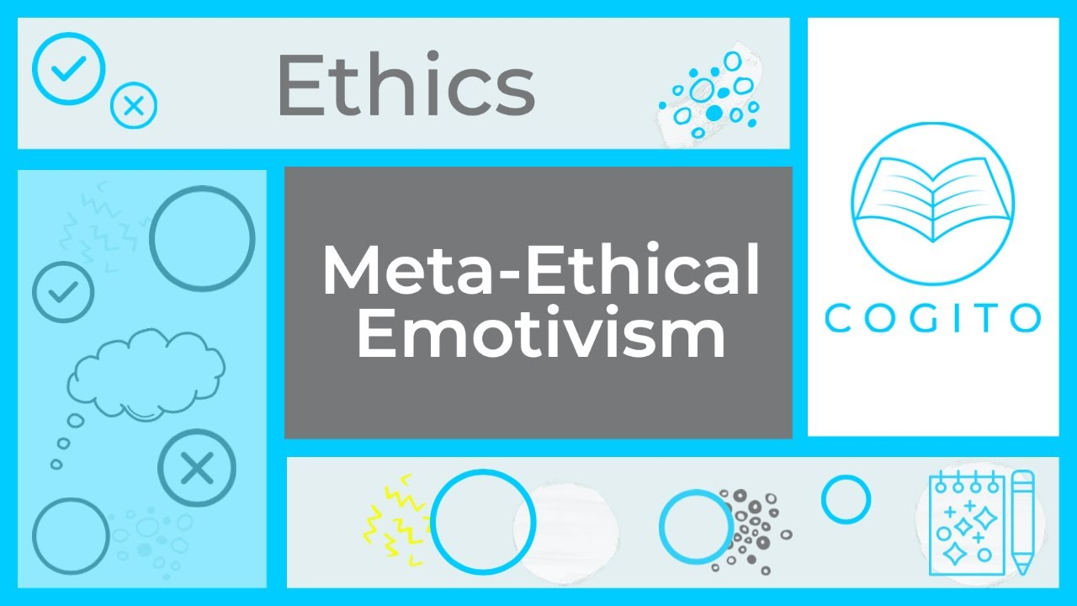
Ethical Emotivism
Ethical Emotivism is a branch of metaethics that holds the view that the view that moral judgments do not function as statements of fact but rather as expressions of the speaker's or writer's feelings.

